Slide 1
Variational Auto-Encoder
Lecture 9
Part 1
Generative AI for Computer Vision

Slide 2
Content
Auto-Encoder
Variational Auto-Encoder – An Introduction
Variational Auto-Encoder
  Encoding – Sampling – Decoding
  Statistical Understanding
  Problem Formulation

Slide 3

Different Generative Models
Tractable Density
Fully Visible Belief Nets
NADE
MADE
Pixel RNN
Change of variable models (nonlinear ICA)
Explicit Density
Markov Chain
Boltzmann Machine
Generative Models
Approximate Density
Variational
Variational Autoencoder
Direct
Implicit Density
GAN
Markov Chain
GSN
Figure copyright and adapted from Ian Goodfellow, Tutorial on Generative Adversarial Networks, 2017.

Slide 4
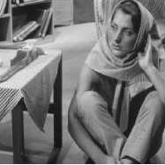
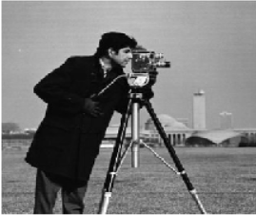
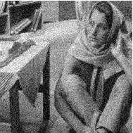
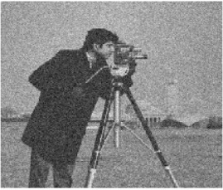
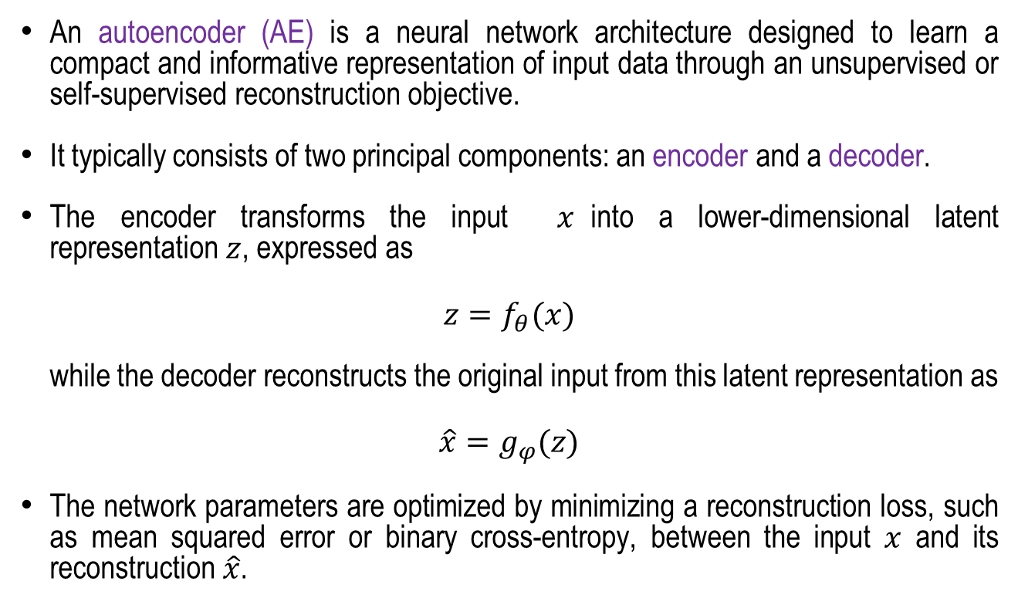



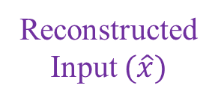
Auto-Encoder
An autoencoder (AE) is a neural network architecture designed to learn a compact and informative representation of input data through an unsupervised or self-supervised reconstruction objective.
It typically consists of two principal components: an encoder and a decoder.
The encoder transforms the input $x$into a lower-dimensional latent representation $z$, expressed as
$$z=f_{θ}(x)$$
while the decoder reconstructs the original input from this latent representation as
$$\hat{x}=g_{φ}(z)$$
The network parameters are optimized by minimizing a reconstruction loss, such as mean squared error or binary cross-entropy, between the input $x$ and its reconstruction $\hat{x}$.
Input ($x$)
Encoder
$$z=f_{θ}(x)$$
Latent Space
z
Decoder
$$\hat{x}=g_{φ}(z)$$
Reconstructed Input $(\hat{x})$

Slide 5


Auto-Encoder
By imposing a bottleneck or other constraints on the latent space, the autoencoder is encouraged to capture the most salient features and underlying structure of the input data while suppressing redundant or irrelevant information.
Consequently, autoencoders have been widely applied to dimensionality reduction, feature extraction, image reconstruction, denoising, anomaly detection, and representation learning.
Variants such as convolutional autoencoders (CAEs) further incorporate convolutional layers to exploit spatial correlations in image data, making them particularly effective for learning hierarchical visual representations.
Input ($x$)
Encoder
$$z=f_{θ}(x)$$
Latent Space
z
Decoder
$$\hat{x}=g_{φ}(z)$$

Slide 6

Auto-encoder as Generative Model
In a standard autoencoder, the encoder maps an input $x$to a fixed latent vector $z$, which is subsequently used by the decoder to reconstruct the input.
Although this approach is effective for representation learning and dimensionality reduction, the learned latent space may lack a well-defined probabilistic structure, limiting its ability to generate new samples.
So, auto-encoder is not a generative model.
Concept: Fei-Fei Li, Ehsan Adeli, Generative Modelling, Stanford Lecture, 2024

Slide 7
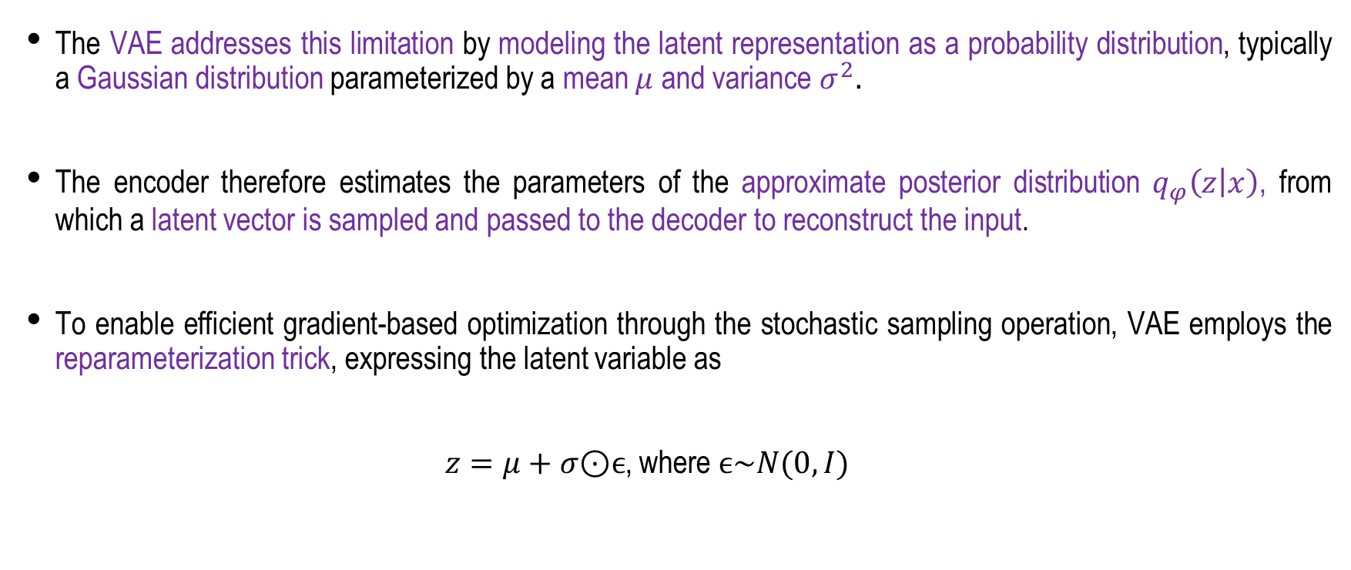
Variational Auto-Encoder
The VAE addresses this limitation by modeling the latent representation as a probability distribution, typically a Gaussian distribution parameterized by a mean $μ$ and variance $σ^{2}.$
The encoder therefore estimates the parameters of the approximate posterior distribution $q_{φ}\left(z | x\right)$, from which a latent vector is sampled and passed to the decoder to reconstruct the input.
To enable efficient gradient-based optimization through the stochastic sampling operation, VAE employs the reparameterization trick, expressing the latent variable as
$z=μ+σ\text{⊙}ϵ$, where $ϵ\sim N(0,I)$

Slide 8


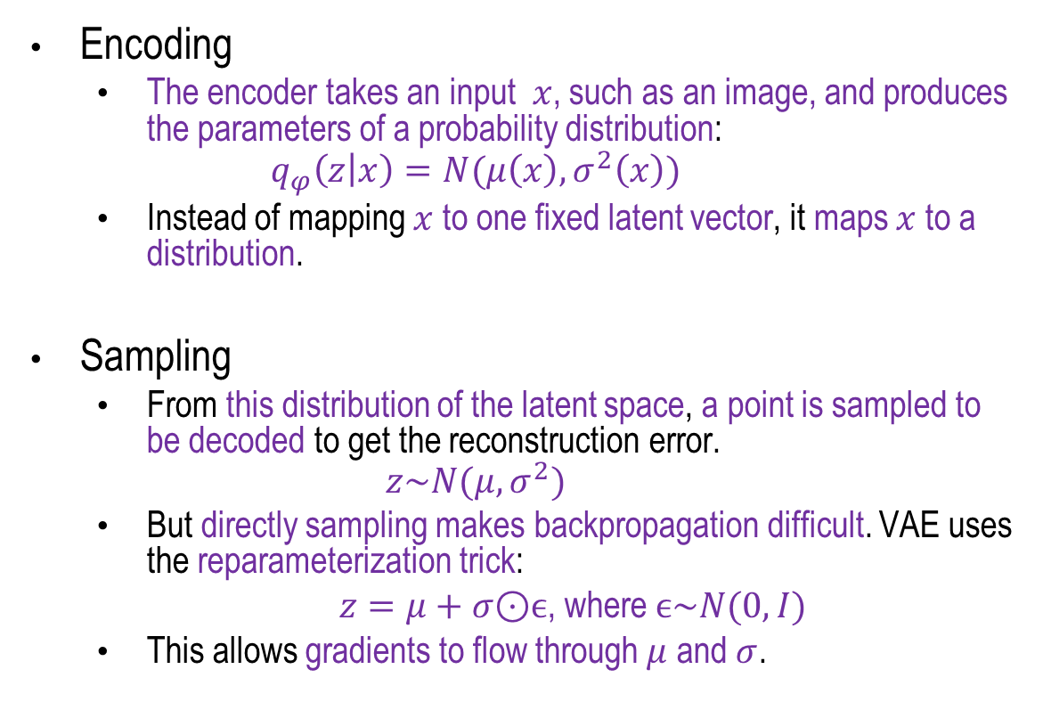





Variational Auto-Encoder
Encoding – Sampling – Decoding
Encoding
  The encoder takes an input $x$, such as an image, and produces the parameters of a probability distribution:
  $$q_{φ}\left(z | x\right)=N(μ\left(x\right),σ^{2}\left(x\right))$$
  Instead of mapping $x$ to one fixed latent vector, it maps $x$ to a distribution.
Sampling
  From this distribution of the latent space, a point is sampled to be decoded to get the reconstruction error.
  $$z\sim N(μ,σ^{2})$$
  But directly sampling makes backpropagation difficult. VAE uses the reparameterization trick:
  $z=μ+σ\text{⊙}ϵ$, where $ϵ\sim N(0,I)$
  This allows gradients to flow through $μ$ and $σ$.
$$X$$
$$q_{ϕ}(z|x)$$
Probabilistic Encoder
$$N(μ_{x},σ_{x})$$
$$μ_{x}σ_{x}$$
p(z|x)
Sampled
z ~ p(z|x)
$$Z\sim N(μ_{x},σ_{x})$$
Probabilistic
Decoder
$$p_{θ}(x|z)$$
$$\hat{X}=d(z)$$

Slide 9

Variational Auto-Encoder
Encoding – Sampling – Decoding
$$X$$
Decoding
  The decoder takes $z$ and reconstructs the input:
  $$p_{θ}\left(x | z\right)$$
$$q_{ϕ}(z|x)$$
Probabilistic Encoder
$$N(μ_{x},σ_{x})$$
$$μ_{x}σ_{x}$$
p(z|x)
Sampled
z ~ p(z|x)
$$Z\sim N(μ_{x},σ_{x})$$
Probabilistic
Decoder
$$p_{θ}(x|z)$$
$$\hat{X}=d(z)$$

Slide 10
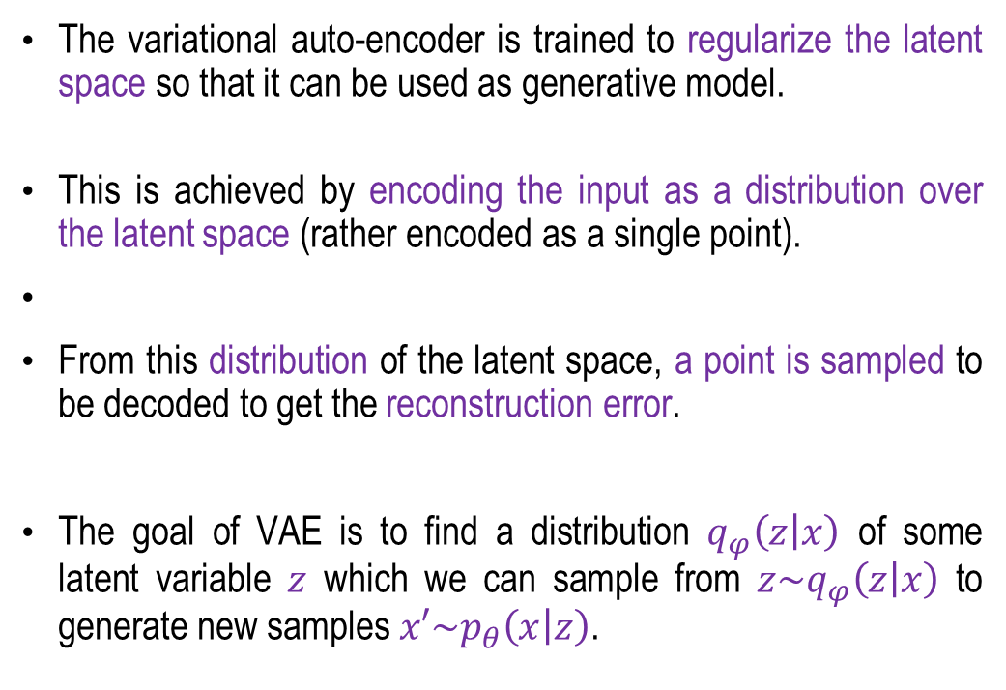
Variational Auto-Encoder
$$X$$
The variational auto-encoder is trained to regularize the latent space so that it can be used as generative model.
This is achieved by encoding the input as a distribution over the latent space (rather encoded as a single point).
From this distribution of the latent space, a point is sampled to be decoded to get the reconstruction error.
The goal of VAE is to find a distribution $q_{φ}\left(z | x\right)$ of some latent variable $z$ which we can sample from ${z\sim q}_{φ}\left(z | x\right)$ to generate new samples ${x′\sim p}_{θ}\left(x | z\right)$.
$$q_{ϕ}(z|x)$$
Probabilistic Encoder
$$N(μ_{x},σ_{x})$$
$$μ_{x}σ_{x}$$
p(z|x)
Sampled
z ~ p(z|x)
$$Z\sim N(μ_{x},σ_{x})$$
Probabilistic
Decoder
$$p_{θ}(x|z)$$
$$\hat{X}=d(z)$$
Concept: Fei-Fei Li, Ehsan Adeli, Generative Modelling, Stanford Lecture, 2024

Slide 11
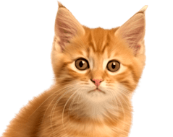
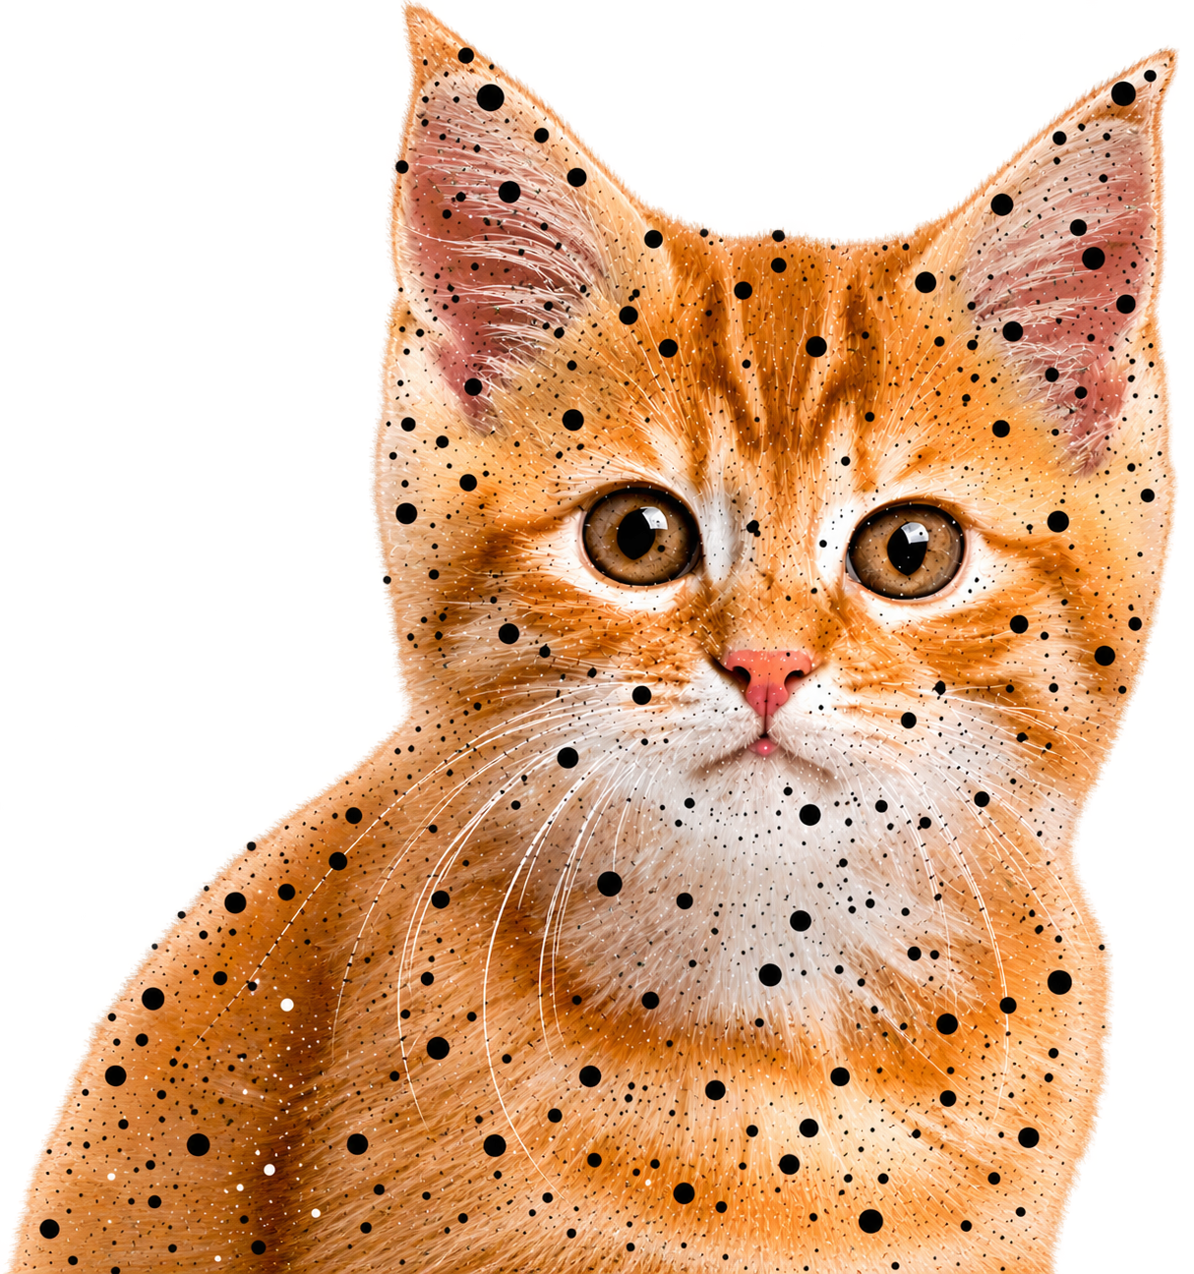
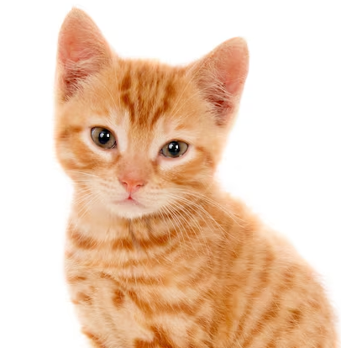
Variational Auto-encoder
Encoder
Encoder
L (Latent space)
0.9 0.3 0.1 0.2 0.7 0.5
Values
L (Latent space)
Distributions
Decoder
Generator
Decoder
Generator
Auto-Encoder
Variational Auto-Encoder

Slide 12
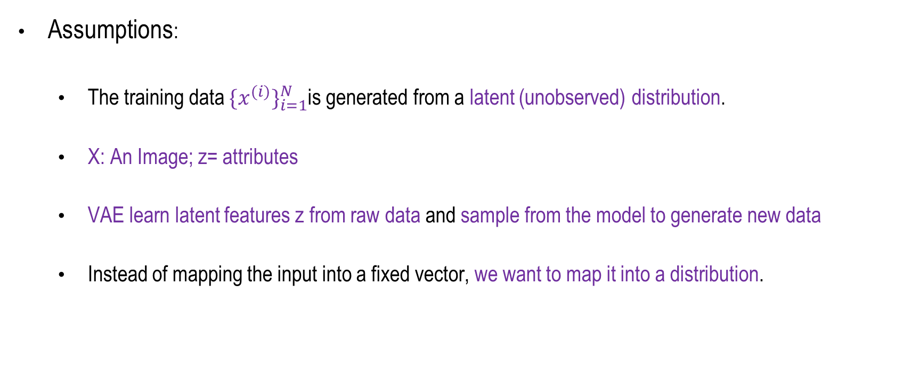
Variational Auto-encoder
Statistical Understanding
Assumptions:
  The training data ${\{x^{(i)}\}}_{i=1}^{N}$is generated from a latent (unobserved) distribution.
  X: An Image; z= attributes
  VAE learn latent features z from raw data and sample from the model to generate new data
  Instead of mapping the input into a fixed vector, we want to map it into a distribution.
Concept: Fei-Fei Li, et. al. Generative Modelling, Stanford Lecture, 2026
Weng, Lilian. (2018). From Autoencoder to Beta-VAE, Lil’Log. "https://lilianweng.github.io/posts/2018-08-12-vae/"

Slide 13
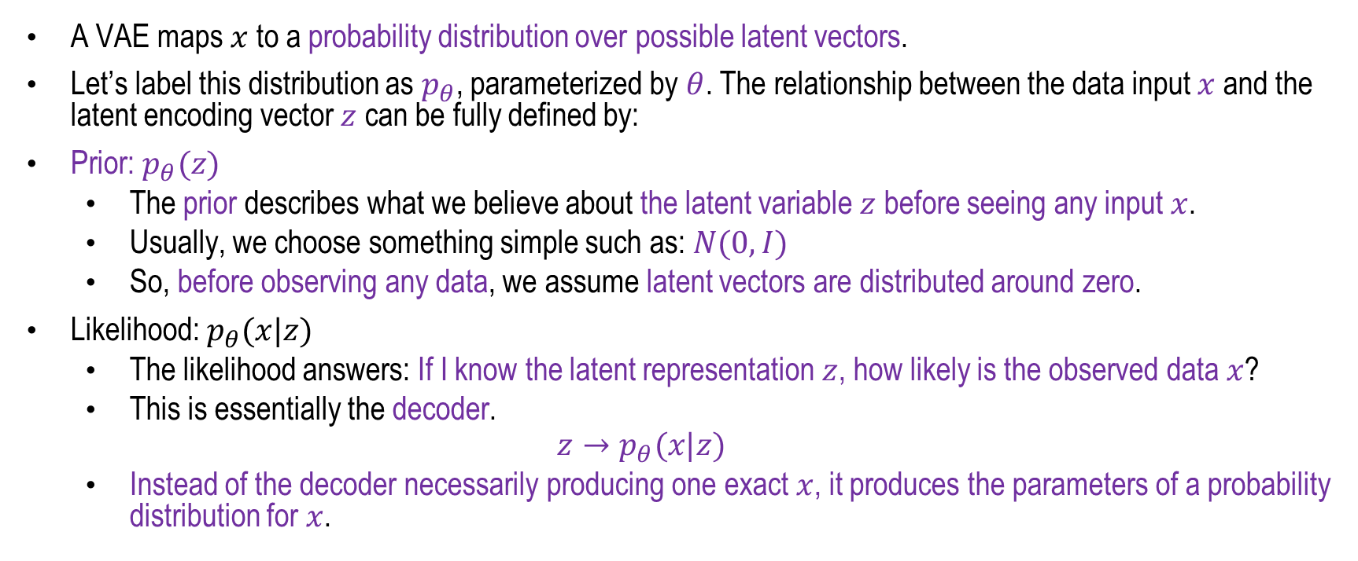
Variational Auto-encoder
Statistical Understanding
A VAE maps $x$ to a probability distribution over possible latent vectors.
Let’s label this distribution as $p_{θ}$, parameterized by $θ$. The relationship between the data input $x$ and the latent encoding vector $z$ can be fully defined by:
Prior: $p_{θ}(z)$
  The prior describes what we believe about the latent variable $z$ before seeing any input $x$.
  Usually, we choose something simple such as: $N(0,I)$
  So, before observing any data, we assume latent vectors are distributed around zero.
Likelihood: $p_{θ}(x|z)$
  The likelihood answers: If I know the latent representation $z$, how likely is the observed data $x$?
  This is essentially the decoder.
  $$z→p_{θ}(x|z)$$
  Instead of the decoder necessarily producing one exact $x$, it produces the parameters of a probability distribution for $x$.
Weng, Lilian. (2018). From Autoencoder to Beta-VAE, Lil’Log. "https://lilianweng.github.io/posts/2018-08-12-vae/"

Slide 14

Variational Auto-encoder
Statistical Understanding
Posterior: $p_{θ}(z|x)$
  The posterior goes in the opposite direction: Given an observed input $x$, which latent values $z$are plausible?
  Conceptually: $x→p_{θ}(z|x)$
  This is what the Encoder tries to learn.
Weng, Lilian. (2018). From Autoencoder to Beta-VAE, Lil’Log. "https://lilianweng.github.io/posts/2018-08-12-vae/"

Slide 15
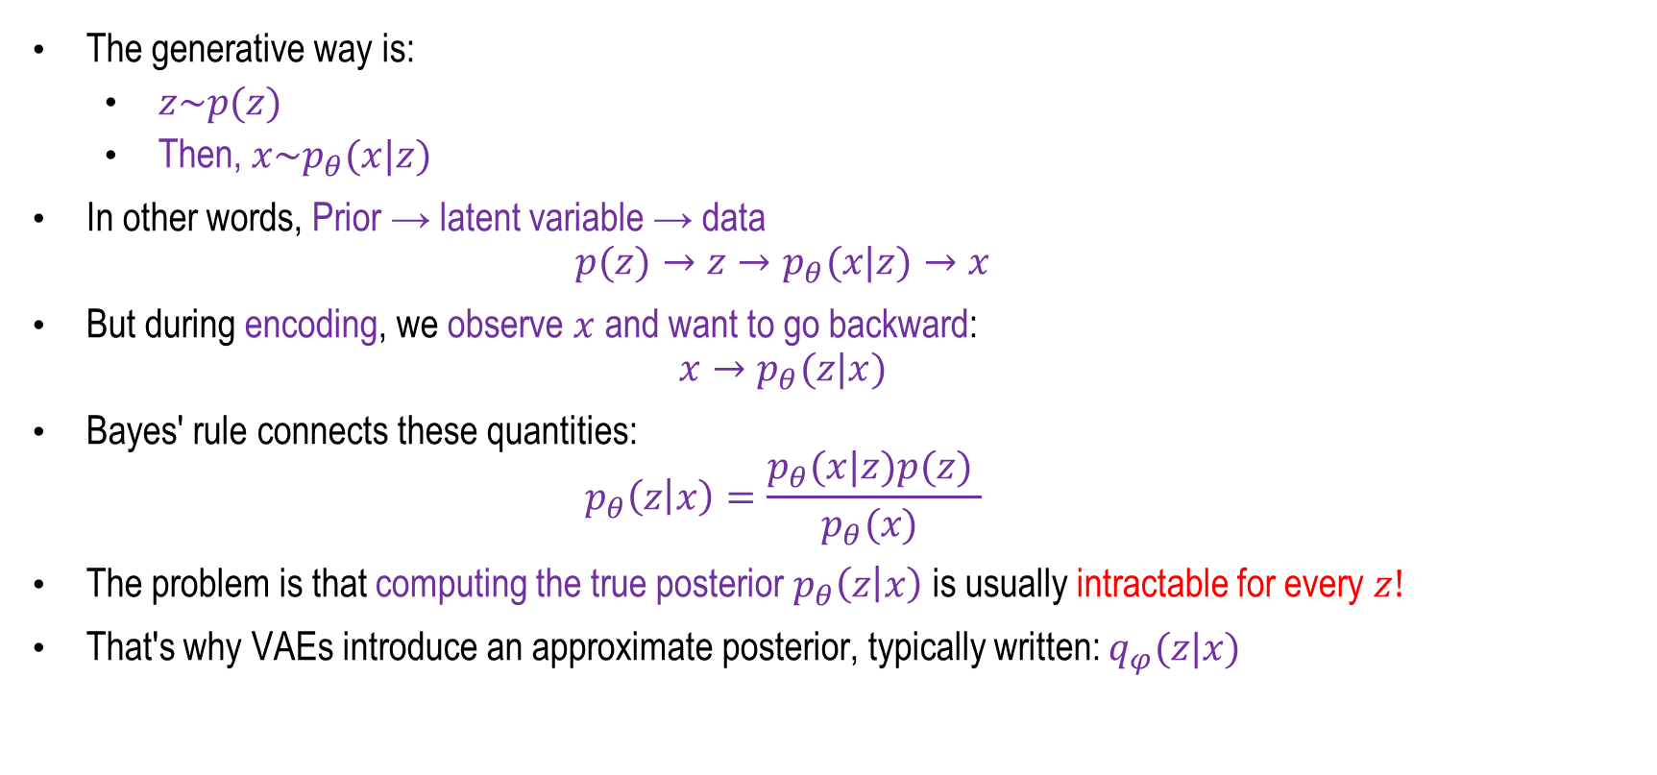
Generative Learning
The generative way is:
  $z\sim p(z)$
  Then, $x\sim p_{θ}(x|z)$
In other words, Prior → latent variable → data
  $$p(z)→z→p_{θ}(x|z)→x$$
But during encoding, we observe $x$and want to go backward:
  $$x→p_{θ}(z|x)$$
Bayes' rule connects these quantities:
  $$p_{θ}\left(z | x\right)=\frac{p_{θ}(x|z)p(z) }{p_{θ}(x) }$$
The problem is that computing the true posterior $p_{θ}\left(z | x\right)$ is usually intractable for every $z!$
That's why VAEs introduce an approximate posterior, typically written: $q_{φ}(z|x)$
Weng, Lilian. (2018). From Autoencoder to Beta-VAE, Lil’Log. "https://lilianweng.github.io/posts/2018-08-12-vae/"

Slide 16


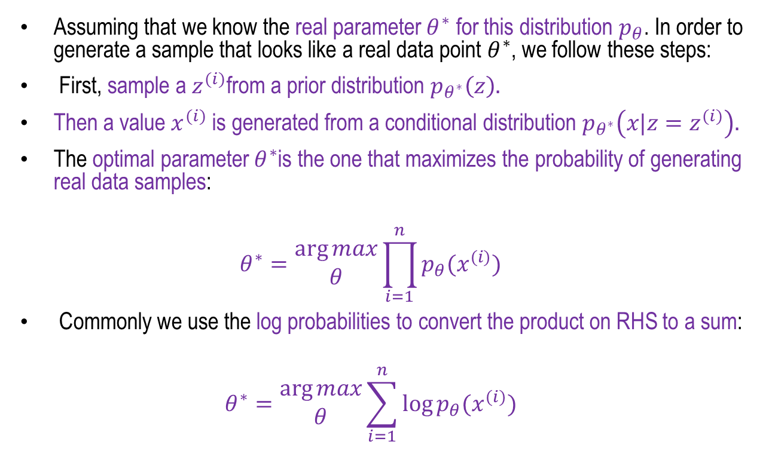
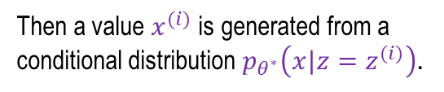
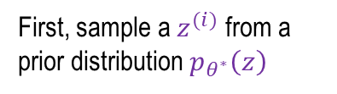
Variational Auto-encoder
In another view-point
Assuming that we know the real parameter $θ^{∗}$ for this distribution $p_{θ}$. In order to generate a sample that looks like a real data point $θ^{∗}$, we follow these steps:
First, sample a $z^{(i)}$from a prior distribution $p_{θ^{∗}}\left(z\right).$
Then a value $x^{(i)}$ is generated from a conditional distribution $p_{θ^{∗}}\left(x|z=z^{(i)}\right).$
The optimal parameter $θ^{∗}$is the one that maximizes the probability of generating real data samples:
$$θ^{∗}=\begin{matrix}\arg{max} \\ θ\end{matrix}\prod_{i=1}^{n}{p_{θ}(x^{(i)})}$$
Commonly we use the log probabilities to convert the product on RHS to a sum:
$$θ^{∗}=\begin{matrix}\arg{max} \\ θ\end{matrix}\sum_{i=1}^{n}{\log{p_{θ}(x^{(i)})}}$$
Then a value $x^{(i)}$ is generated from a conditional distribution $p_{θ^{∗}}\left(x|z=z^{(i)}\right).$
First, sample a $z^{(i)}$ from a prior distribution $p_{θ^{∗}}\left(z\right)$
Weng, Lilian. (2018). From Autoencoder to Beta-VAE, Lil’Log. "https://lilianweng.github.io/posts/2018-08-12-vae/"

Slide 17
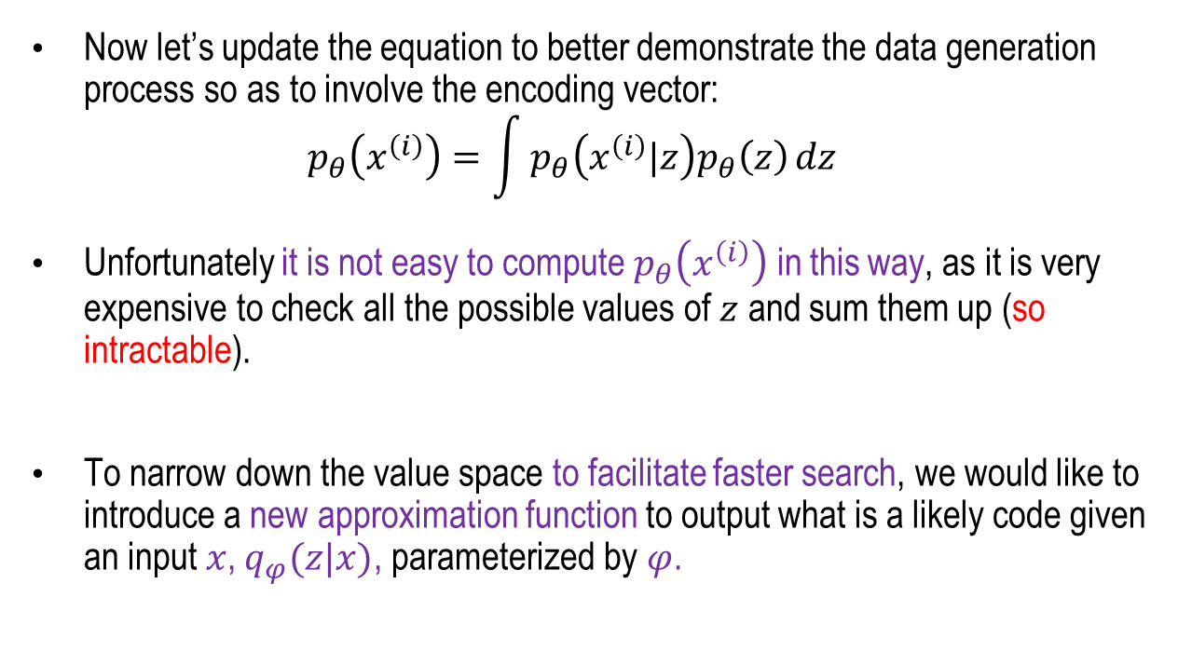
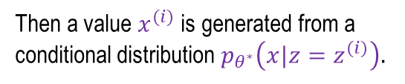

Variational Auto-encoder
In another view-point
Now let’s update the equation to better demonstrate the data generation process so as to involve the encoding vector:
$$p_{θ}\left(x^{\left(i\right)}\right)=\int{p_{θ}\left(x^{\left(i\right)}|z\right)p_{θ}\left(z\right)}dz$$
Unfortunately it is not easy to compute $p_{θ}\left(x^{\left(i\right)}\right)$ in this way, as it is very expensive to check all the possible values of $z$ and sum them up (so intractable).
To narrow down the value space to facilitate faster search, we would like to introduce a new approximation function to output what is a likely code given an input $x$, $q_{φ}(z|x)$, parameterized by $φ$.
Then a value $x^{(i)}$ is generated from a conditional distribution $p_{θ^{∗}}\left(x|z=z^{(i)}\right).$
First, sample a $z^{(i)}$ from a prior distribution $p_{θ^{∗}}\left(z\right)$
Weng, Lilian. (2018). From Autoencoder to Beta-VAE, Lil’Log. "https://lilianweng.github.io/posts/2018-08-12-vae/"

Slide 18

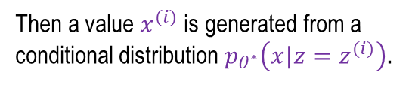
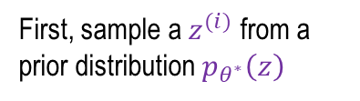
Variational Auto-encoder
In another view-point
How should we represent this model?
Choose prior p(z) is simple e.g. Gaussian.
Reasonable for latent attributes.
Conditional p(x|z) is complex. It can be represented with neural network.
How to train the model?
Then a value $x^{(i)}$ is generated from a conditional distribution $p_{θ^{∗}}\left(x|z=z^{(i)}\right).$
Decoder Network
First, sample a $z^{(i)}$ from a prior distribution $p_{θ^{∗}}\left(z\right)$
Concept: Fei-Fei Li, et. al. Generative Modelling, Stanford Lecture, 2024

Slide 19
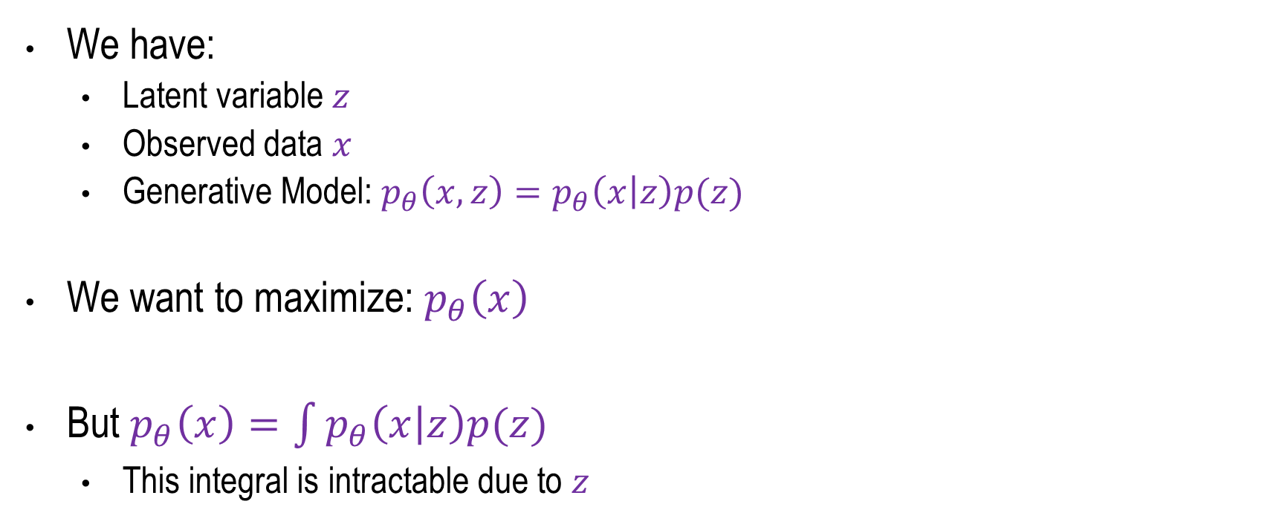
Variational Auto-encoder
Problem Formulation
We have:
  Latent variable $z$
  Observed data $x$
  Generative Model: $p_{θ}\left(x,z\right)=p_{θ}\left(x | z\right)p(z)$
We want to maximize: $p_{θ}\left(x\right)$
But $p_{θ}\left(x\right)=\int{p_{θ}\left(x | z\right)p(z) }$
  This integral is intractable due to $z$
Concept: Fei-Fei Li, et. al. Generative Modelling, Stanford Lecture, 2024

Slide 20
Summary
Auto-Encoder
Variational Auto-Encoder – An Introduction
Variational Auto-Encoder
  Encoding – Sampling – Decoding
  Statistical Understanding
  Problem Formulation

Slide 21
Variational Auto-Encoder - II
Next
Lecture 9: Part 2
Generative AI for Computer Vision

